Slide 1
Simplified
Critical-State Soil Mechanics
08 July 2014
Paul W. Mayne
Georgia Institute of Technology

Slide 2
PROLOGUE
Critical-state soil mechanics is an effective stress framework describing mechanical soil response
In its simple form here, we consider only shear loading and compression-swelling.
We merely tie together two well-known concepts: (1) one-dimensional consolidation behavior (via e-logσ_{v}’ curves); and (2) shear stress-vs. normal stress (τ−σ_{v}’) plots from direct shear (alias Mohr’s circles).

Slide 3
Critical State Soil Mechanics (CSSM)
Experimental evidence
  1936 by Hvorslev (1960, ASCE)
  Henkel (1960, ASCE Boulder)
  Parry (1961)
  Kulhawy & Mayne (1990): Summary of 200+ soils
Mathematics presented elsewhere
  Schofield & Wroth (1968)
  Roscoe & Burland (1968)
  Wood (1990)
  Jefferies & Been (2006)
Basic form: 3 material constants (φ', C_{c}, C_{s}) plus initial state parameter (e₀, σ_{vo}', OCR)

Slide 4
Critical State Soil Mechanics (CSSM)
Constitutive Models in FEM packages:
  Original Cam-Clay (1968)
  Modified Cam Clay (1969)
  NorSand (Jefferies 1993)
  Bounding Surface (Dafalias)
  MIT-E3 (Whittle, 1993)
  MIT-S1 (Pestana, 1999; 2001)
  Cap Model
  “Ber-Klay” (Univ. California)
  others (Adachi, Oka, Ohta, Dafalias, Nova, Wood, Huerkel)
"Undrained" is just one specific stress path
Yet !!! CSSM is missing from most textbooks and undergrad & grad curricula.

Slide 5
One-Dimensional Consolidation
σ_{vo}'=300 kPa
σ_{p}'=900 kPa
C_{r} = 0.04
Overconsolidation Ratio, OCR = 3
C_{s} = swelling index (= C_{r})
c_{v} = coef. of consolidation
D' = constrained modulus
C_{αe} = coef. secondary compression
k ≈ hydraulic conductivity
C_{c} = 0.38
σ_{v}’

Slide 6
Direct Shear Test Results
τ
τ
σ_{v}’
τ
τ
σ_{v}’
δ
γ_{s}
Direct Shear Box (DSB)
Direct Simple Shear (DSS)

Slide 7
CSSM for Dummies
C_{C}
σ_{CSL}’ ≈ ½σ_{NC}’
Void Ratio, e
Void Ratio, e
e₀
NC
NC
CSL
CSL
σ_{CSL}’ σ_{NC}’
Log σ_{v}'
Effective stress σ_{v}'
CSL
tanφ'
CSSM Premise:
“All stress paths fail on the critical state line (CSL)”
Shear stress τ
φ′
c′=0
Effective stress σ_{v}'

Slide 8
CSSM for Dummies
C_{C}
Void Ratio, e
Void Ratio, e
e₀
NC
Δe
NC
e_{f}
CSL
CSL
σ_{vo}′
Effective stress σ_{v}'
Log σ_{v}'
CSL
τ_{max} = c′ + σ′ tanφ′
STRESS PATH No.1
NC Drained Soil
tanφ'
Shear stress τ
Given: e₀, σ_{vo}’, NC (OCR=1)
Drained Path: Δu = 0
Volume Change is Contractive: ε_{vol} = Δe/(1+e₀) < 0
c’=0
σ_{vo}′
Effective stress σ_{v}'

Slide 9
CSSM for Dummies
C_{C}
Void Ratio, e
Void Ratio, e
e₀
NC
NC
CSL
CSL
σ_{vf}′
σ_{vo}′
Effective stress σ_{v}'
Log σ_{v}'
CSL
STRESS PATH No.2
NC Undrained Soil
tanφ'
τ_{max} = c_{u}=s_{u}
Δu
Given: e₀, σ_{vo}’, NC (OCR=1)
Shear stress τ
Undrained Path: ΔV/V₀ = 0
+Δu = Positive Excess Porewater Pressures
σ_{vf}′
σ_{vo}′
Effective stress σ_{v}'

Slide 10
CSSM for Dummies
C_{C}
Void Ratio, e
Void Ratio, e
NC
NC
CSL
CSL
Log σ_{v}'
Effective stress σ_{v}'
CSL
Note: All NC undrained
stress paths are parallel
to each other, thus:
s_{u}/σ_{vo}’ = constant
tanφ'
Shear stress τ
DSS: s_{u}/σ_{vo}’_{NC} = ½sinφ’
Effective stress σ_{v}'

Slide 11
CSSM for Dummies
C_{C}
Void Ratio, e
Void Ratio, e
OC
C_{S}
NC
NC
CSL
CSL
Log σ_{v}'
σ_{p}'
Effective stress σ_{v}'
CSL
Overconsolidated States:
e₀, σ_{vo}’, and OCR = σ_{p}’/σ_{vo}’
where σ_{p}’ = σ_{vmax}’ = P_{c}’ =
preconsolidation stress;
OCR = overconsolidation ratio
tanφ'
Shear stress τ
Effective stress σ_{v}'
σ_{p}'

Slide 12
CSSM for Dummies
C_{C}
e₀
Void Ratio, e
Void Ratio, e
OC
C_{S}
NC
NC
CSL
CSL
σ_{vo}'
σ_{vf}'
Log σ_{v}'
Effective stress σ_{v}'
CSL
Stress Path No. 3
Undrained OC Soil:
e₀, σ_{vo}’, and OCR
tanφ'
Shear stress τ
Δu
Stress Path: ΔV/V₀ = 0
Negative Excess Δu
σ_{vo}'
Effective stress σ_{v}'

Slide 13
CSSM for Dummies
C_{C}
e₀
Void Ratio, e
Void Ratio, e
OC
C_{S}
NC
NC
CSL
CSL
σ_{vo}'
Log σ_{v}'
Effective stress σ_{v}'
CSL
Stress Path No. 4
Drained OC Soil:
e₀, σ_{vo}’, and OCR
tanφ'
Shear stress τ
Stress Path: Δu = 0
Dilatancy: ΔV/V₀ > 0
σ_{vo}'
Effective stress σ_{v}'

Slide 14
Critical state soil mechanics
Initial state: e₀, σ_{vo}’, and OCR = σ_{p}’/σ_{vo}’
Soil constants: φ’, C_{c}, and C_{s} (Λ = 1-C_{s}/C_{c})
For NC soil (OCR =1):
  Undrained (ε_{vol} = 0): +Δu and τ_{max} = s_{u} = c_{u}
  Drained (Δu = 0) and contractive (decrease ε_{vol})
For OC soil:
  Undrained (ε_{vol} = 0): -Δu and τ_{max} = s_{u} = c_{u}
  Drained (Δu = 0) and dilative (Increase ε_{vol})
There’s more !
Semi-drained, Partly undrained, Cyclic response…..

Slide 15
Equivalent Stress Concept
C_{C}
NC
e₀
Void Ratio, e
Void Ratio, e
OC
NC
Δe
C_{S}
σ_{p}'
σ_{p}'
e_{p}
CSL
CSL
σ_{vo}'
σ_{vf}'
σ_{e}'
Log σ_{v}'
Effective stress σ_{v}'
1. OC State (e_{o}, σ_{vo}’, σ_{p}’)
CSL
2. Project OC state to NC line for equivalent stress, σ_{e}’
tanφ'
Shear stress τ
s_{u}
Δe = C_{s} log(σ_{p}’/σ_{vo}’)
Δe = C_{c} log(σ_{e}’/σ_{p}’)
at σ_{e}’
s_{uOC} = s_{uNC}
3. σ_{e}’ = σ_{vo}’ OCR^{[1-Cs/Cc]}
σ_{vo}'
σ_{e}'
Stress σ_{v}'

Slide 16
Critical state soil mechanics
Previously: s_{u}/σ_{vo}’ = constant for NC soil
On the virgin compression line: σ_{vo}’ = σ_{e}’
Thus: s_{u}/σ_{e}’ = constant for all soil (NC & OC)
For simple shear: s_{u}/σ_{e}’ = ½sin φ’
Equivalent stress:
σ_{e}’ = σ_{vo}’ OCR^{[1-Cs/Cc]}
Normalized Undrained Shear Strength:
s_{u}/σ_{vo}’ = ½ sinφ’ OCR^{Λ}
where Λ = (1-C_{s}/C_{c})

Slide 17
Undrained Shear Strength from CSSM

Slide 18
Undrained Shear Strength from CSSM

Slide 19
Porewater Pressure Response from CSSM

Slide 20
Yield Surfaces
NC
NC
CSL
OC
OC
Void Ratio, e
Void Ratio, e
σ_{p}'
CSL
Log σ_{v}'
σ_{p}'
Normal stress σ_{v}'
CSL
Yield Surface
Yield surface represents 3-d preconsolidation
Quasi-elastic behavior within the yield surface
Shear stress τ
Normal stress σ_{v}'

Slide 21
Critical state soil mechanics
This powerpoint: geosystems.ce.gatech.edu
Classic book: Critical -State Soil Mechanics by Schofield & Wroth (1968): http://www.geotechnique.info
Schofield (2005) Disturbed Soil Properties and Geotechnical Design Thomas Telford
Wood (1990): Soil Behaviour and CSSM
Jefferies & Been (2006): Soil liquefaction: a critical-state approach www.informaworld.com

Slide 22
ESA versus TSA
Effective stress analysis (ESA) rules:
  c' = effective cohesion intercept (c' = 0 for OCR < 2 and c' ≈ 0.02 σ_{p}' for short term loading)
  φ' = effective stress friction angle
  τ = c' + σ' tan φ' = Mohr-Coulomb strength criterion
  σ_{v}' = σ_{v} - u₀ - Δu = effective stress
Total stress analysis (TSA) is (overly) simplistic for clay with strength represented by a single parameter, i.e. "φ = 0" and τ_{max} = c = c_{u} = s_{u} = undrained shear strength (implying "Δu = 0")

Slide 23
Explaining the myth that "φ = 0"
The effective friction angle (φ') is usually between 20 to 45 degrees for most soils. However, for clays, we here of "φ = 0" analysis which applies to total stress analysis (TSA). In TSA, there is no knowledge of porewater pressures (PWP). Thus, by ignoring PWP (i.e., Δu = 0), there is an illusional effect that can be explained by CSSM. See the following slides.

Slide 24
(Undrained) Total Stress
Analysis - Consolidated
Undrained Triaxial Tests
Three specimens initially consolidated
to σ_{vc}' = 100, 200, and 400 kPa

Slide 25
(Undrained) Total Stress Analysis
In TSA, however, Δu not known, so plot stress paths for "Δu = 0"
Obtains the illusion that " φ ≈ 0° "
s_{u400}
s_{u200}
s_{u100}

Slide 26
Another set of undrained Total Stress Analyses (TSA) for UU tests on clays:
UU = Unconsolidated Undrained

Slide 27
(Undrained) Total Stress Analysis
Again, Δu not known in TSA, so plot for stress paths for "Δu = 0"
Obtains the illusion that " φ = 0° "
s_{u}

Slide 28
Explaining the myth that "φ = 0"
Effective Stress Analyses (ESA)
  Drained Loading (Δu = 0)
  Undrained Loading (ΔV/V₀ = 0)
Total Stress Analyses (TSA)
  Drained Loading (Δu = 0)
  Undrained Loading with "φ = 0" analysis: ΔV/V₀ = 0 and "Δu = 0"

Slide 29
Cambridge University q-p' space
σ₁'
CSL
σ₂' = σ₃'
Triaxial
Compression
q = (σ₁ - σ₃)
Undrained OC
Stress Path
Undrained NC
Stress Path
Drained
Stress Path
3V : 1H
σ_{vo}' = P₀'
P' = (σ₁' + σ₂' + σ₃')/3

Slide 30
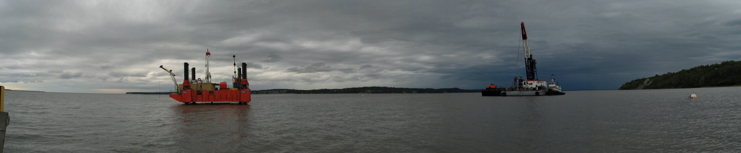
Port of Anchorage, Alaska

Slide 31
Cavity Expansion – Critical State Model for Evaluating
OCR in Clays from Piezocone Tests
where M = 6 sinφ’/(3-sinφ’)
and Λ = 1 – C_{s}/C_{c} ≈ 0.8
f_{s}
u_{b}
q_{c}
→ q_{T}

Slide 32
Cambridge University q-p' space
CSL
q = (σ₁ - σ₃)
Yield Surface
Original Cam Clay
Modified Cam Clay
Bounding Surface
Cap Model
P_{c}'
P' = (σ₁' + σ₂' + σ₃')/3

Slide 33
Anisotropic Yield Surface
CSL
M_{c} = 6sinφ’/(3-sinφ’)
Yield Surface
fctn(K_{0NC})
q = (σ₁ - σ₃)
σ_{p}’
OC
Y₂
e₀
σ_{vo}’
K₀
G₀
Y₁
NC
Y₃ = Limit State
P’ = (σ₁’ + σ₂’ + σ₃’)/3

Slide 34
Cambridge University q-p' space
Yield Surface
CSL
Apparent
M_{c}
fctn(K_{0NC})
q = (σ₁ - σ₃)
σ_{p}’
Ko Unloading
Y₃ = Limit State
P' = (σ₁' + σ₂' + σ₃')/3

Slide 35
MIT q-p' space
Natural Clays
fctn(K_{0NC})
q = ½(σ₁ - σ₃)
Yield Surface
σ_{p}’
Diaz-Rodriguez, Leroueil,
and Aleman (1992, JGE)
OC
P' = ½(σ₁' + σ₃')

Slide 36
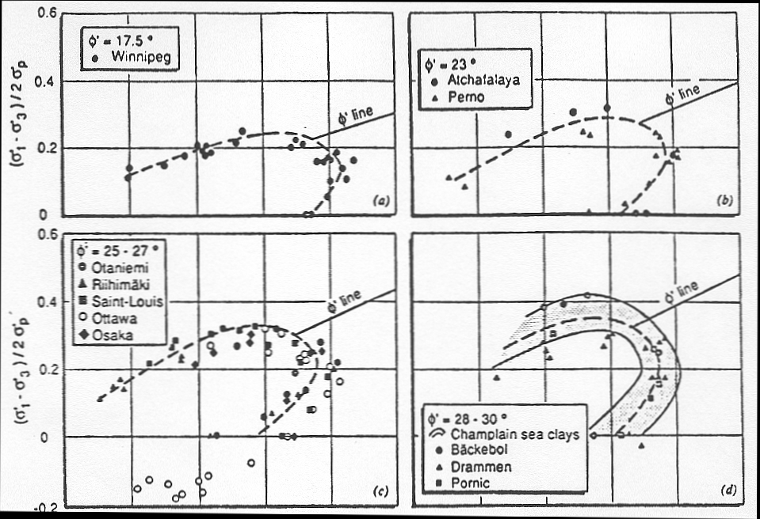
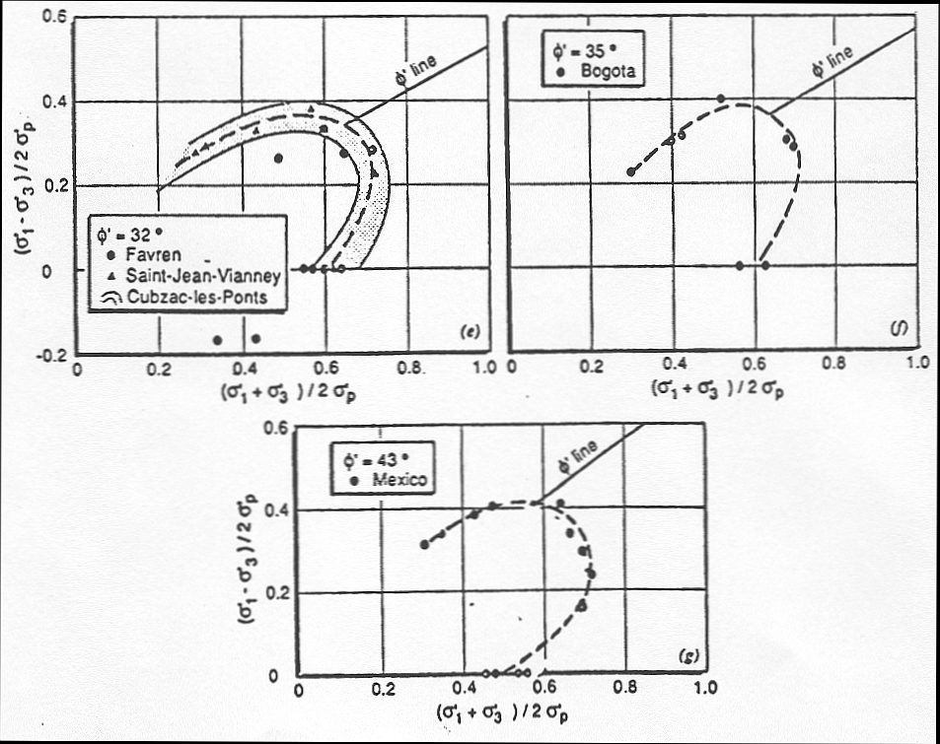
Diaz-Rodriguez, Leroueil, & Aleman (ASCE Journal Geotechnical Engineering July 1992)
Yield Surfaces of Natural Clays

Slide 37
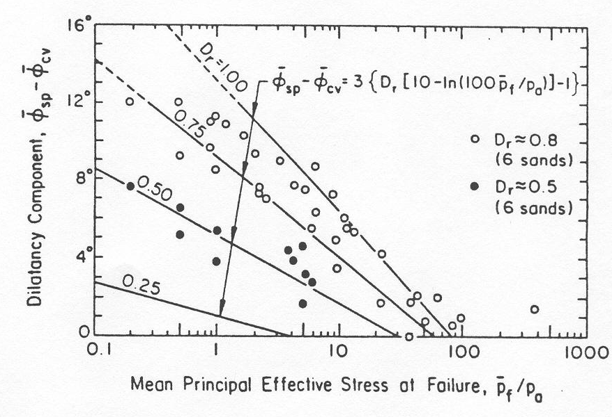
Friction Angle of Clean Quartz Sands
(Bolton, 1986 Geotechnique)

Slide 38
State Parameter for Sands, ψ
(Been & Jefferies, 1985; Jefferies & Been 2006)
λ₁₀
void
ratio
e
λ₁₀
Wet of Critical
(Contractive)
e_{csl}
ψ = e₀ - e_{csl}
e₀
VCL
Dry of Critical (Dilative)
CSL
p₀'
log p'
p' = ⅓ (σ₁'+σ₂'+σ₃')

Slide 39
State Parameter for Sands, ψ
(Simplified Critical State Soil Mechanics)
ψ = (C_{s} - C_{c} )∙log[ ½ cos φ' OCR ]
λ₁₀
Δu = (1 - ½ cos φ' OCR^{Λ} ]∙σ_{vo}'
λ₁₀
void
ratio
e
then CSL = OCR = 2/cosφ'
e_{csl}
ψ = e₀ - e_{csl}
e₀
VCL
CSL
p₀'
p' = ⅓ (σ₁'+σ₂'+σ₃')
log p'

Slide 40
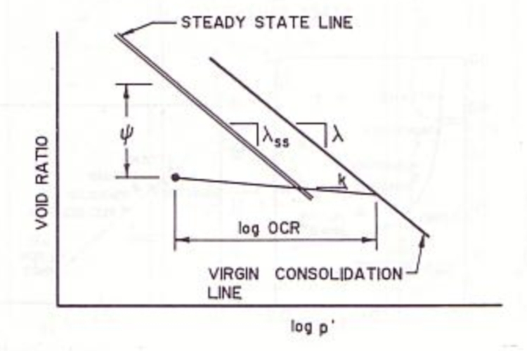
State Parameter for Sands, ψ
(Been, Crooks, & Jefferies, 1988)
log OCR_{p} = log2^{Λ} + Ψ/(κ−λ)
where OCR_{p} = R = overconsolidation ratio in Cambridge q-p' space, Λ = 1−κ/λ, λ = C_{c}/ln(10) = compression index, and κ ≈ C_{s}/ln(10) = swelling index

Slide 41
MIT Constitutive Models
Whittle et al. 1994: JGE Vol. 120 (1) "Model prediction of anisotropic behavior of Boston Blue Clay"
MIT-E3: 15 parameters for clay
Pestana & Whittle (1999) "Formulation of unified constitutive model for clays and sands" Intl. J. for Analytical & Numerical Methods in Geomechanics, Vol. 23
MIT S1: 13 parameters for clay
MIT S1: 14 parameters for sand

Slide 42
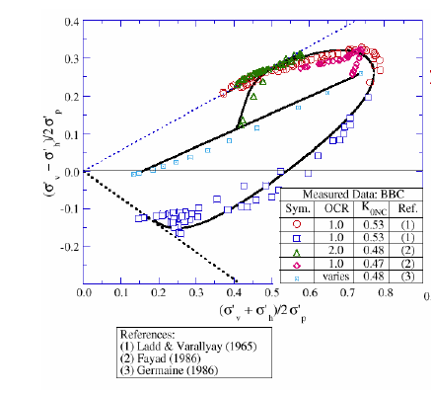
MIT E-3 Constitutive Model
Whittle (2005)

Slide 43
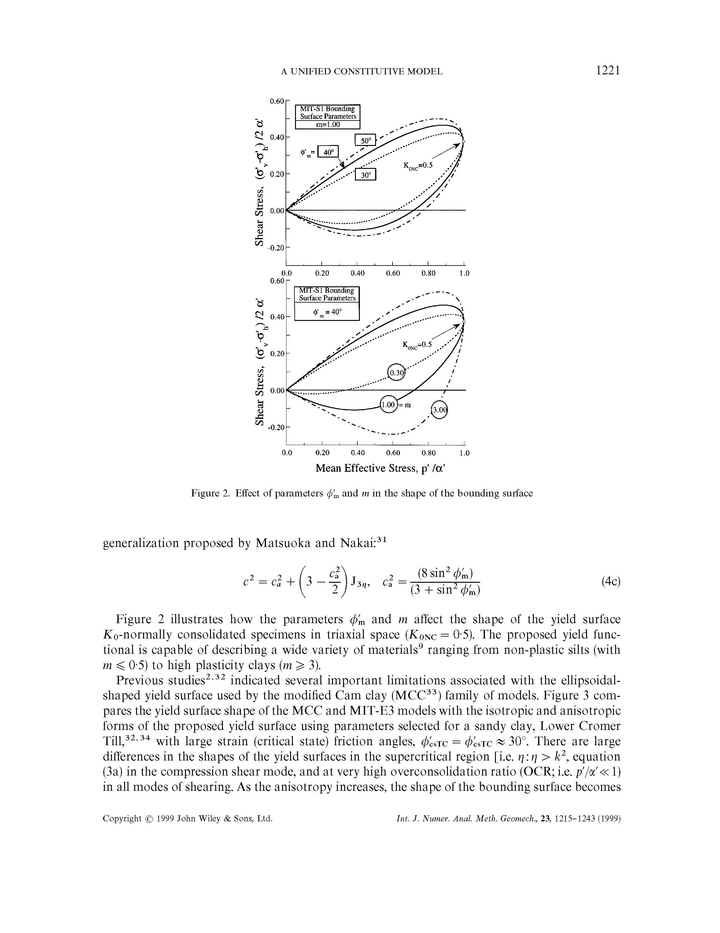
MIT S-1 Constitutive Model
Pestana and Whittle (1999)

Slide 44
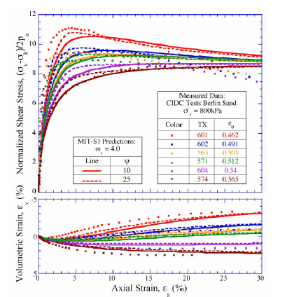
MIT S-1 Constitutive Model
Predictions for
Berlin Sands
(Whittle, 2005)

Slide 45
Critical state soil mechanics
Initial state: e₀, σ_{vo}’, and OCR = σ_{p}’/σ_{vo}’
Soil constants: φ’, C_{c}, and C_{s}
Link between Consolidation and Shear Tests
CSSM addresses:
  NC and OC behavior
  Undrained vs. Drained (and other paths)
  Positive vs. negative porewater pressures
  Volume changes (contractive vs. dilative)
  s_{u}/σ_{vo}’ = ½ sinφ’ OCR^{Λ} where Λ = 1-C_{s}/C_{c}
Yield surface represents 3-d preconsolidation
State parameter: ψ = e₀ - e_{csl}

Slide 46
Simplified Critical State Soil Mechanics
NC
C_{C}
dilative
NC
e_{OC}
consolidation
Void Ratio, e
Void Ratio, e
C_{S}
-Δu
swelling
OC
e_{NC}
+Δu
CSL
CSL
contractive
Log σ_{v}'
σ_{p}'
Effective stress σ_{v}'
φ'
τ_{max} = σ′tanφ′
Four Basic Stress Paths:
1. Drained NC (decrease ΔV/V_{o})
2. Undrained NC (positive Δu)
3. Undrained OC (negative Δu)
4. Drained OC (increase ΔV/V_{o})
CSL
τ_{max} = s_{u NC}
Shear stress τ
2
1
s_{u OC}
Yield
Surface
3
σ_{CS}′≈½σ_{p}′
σ_{p}'
4
τ_{max} = c′+σ′tanφ′
c'
Effective stress σ_{v}'

Slide 47


